Slide 1

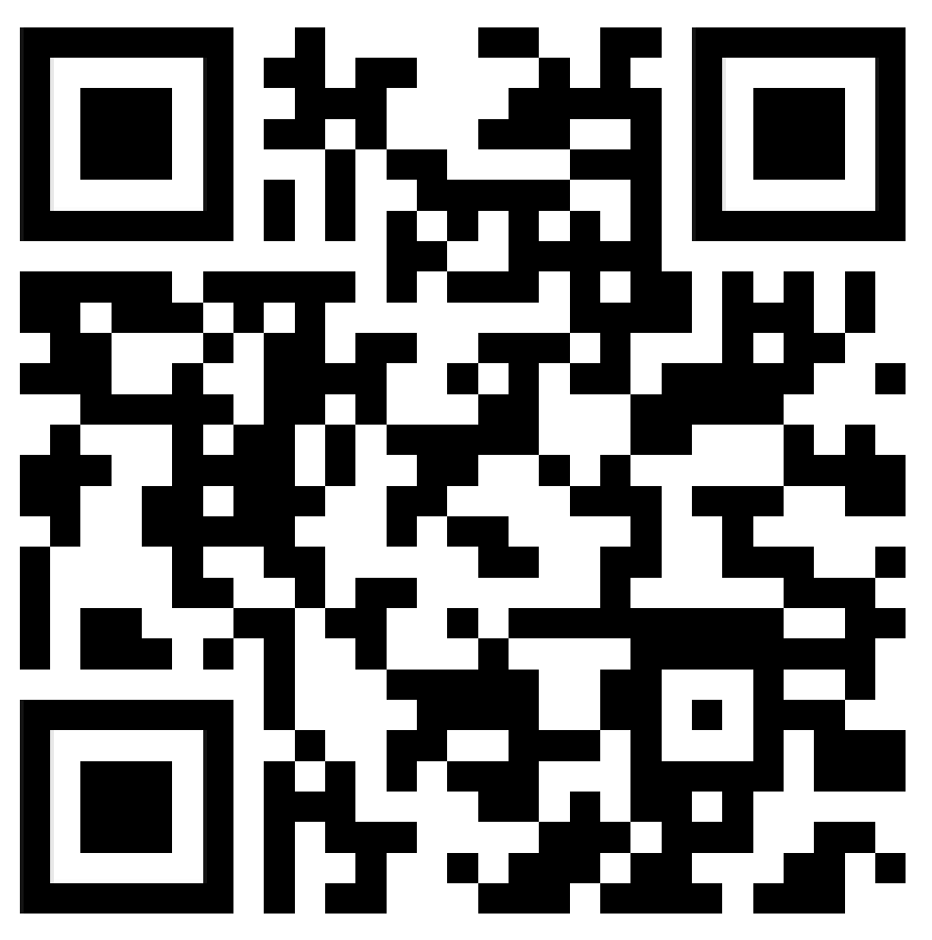
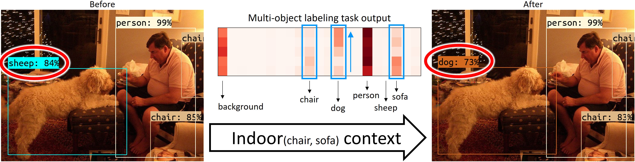
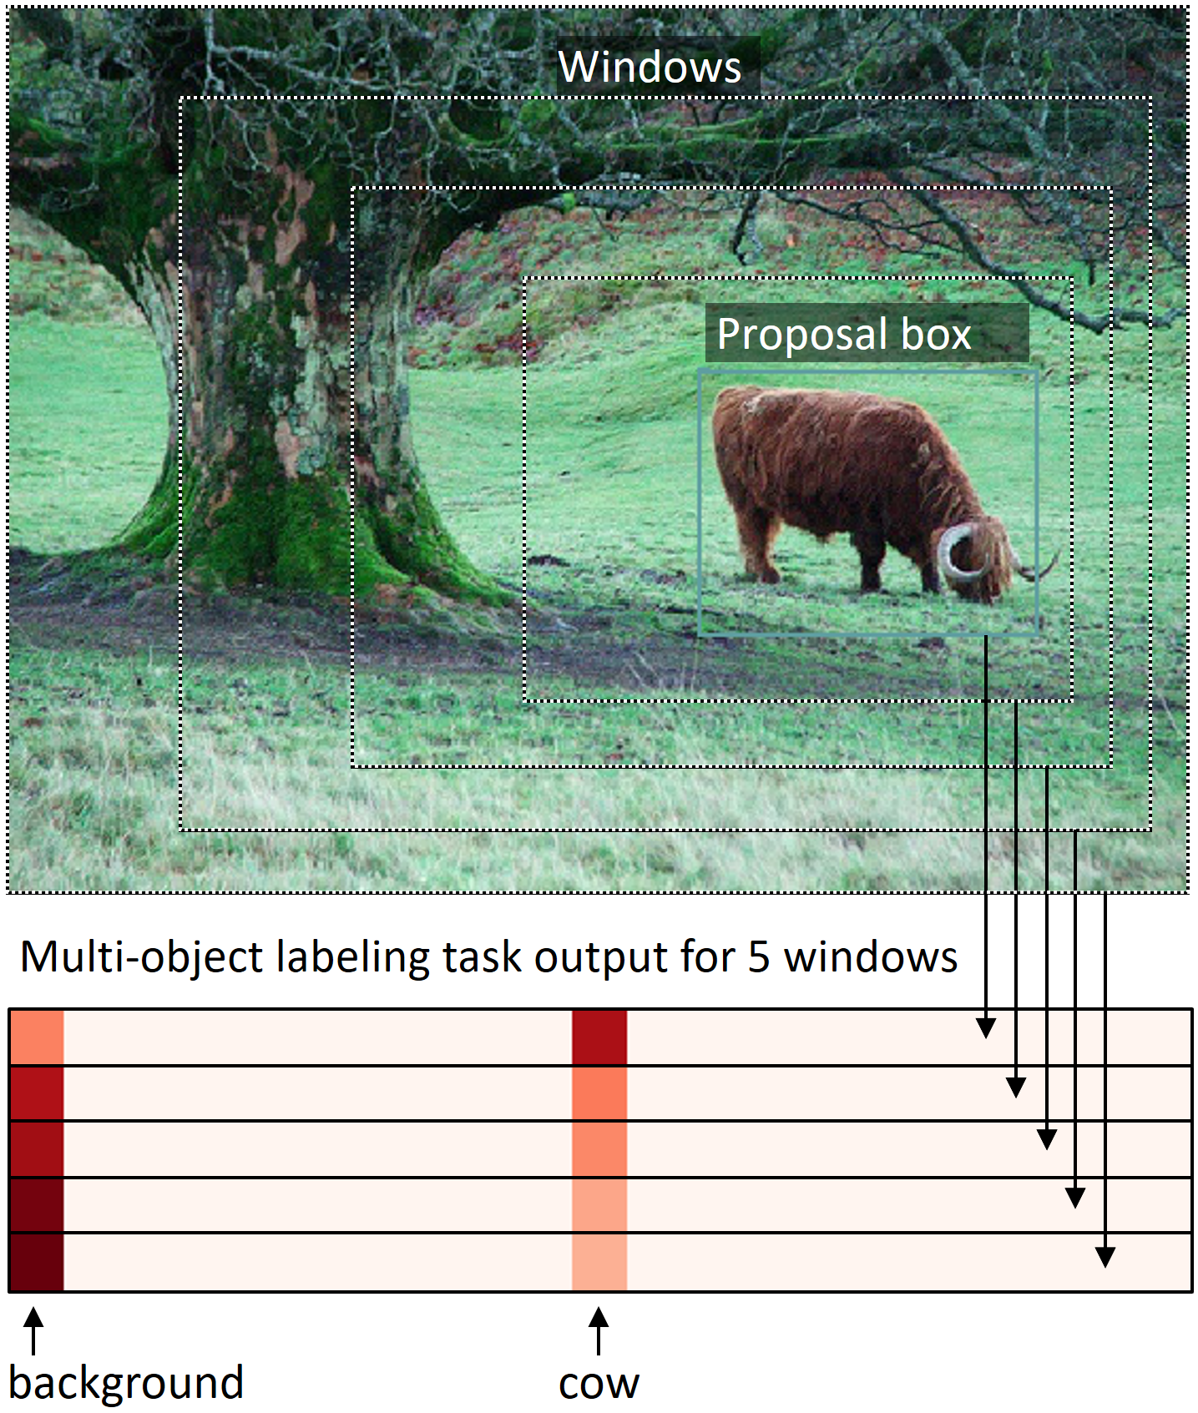
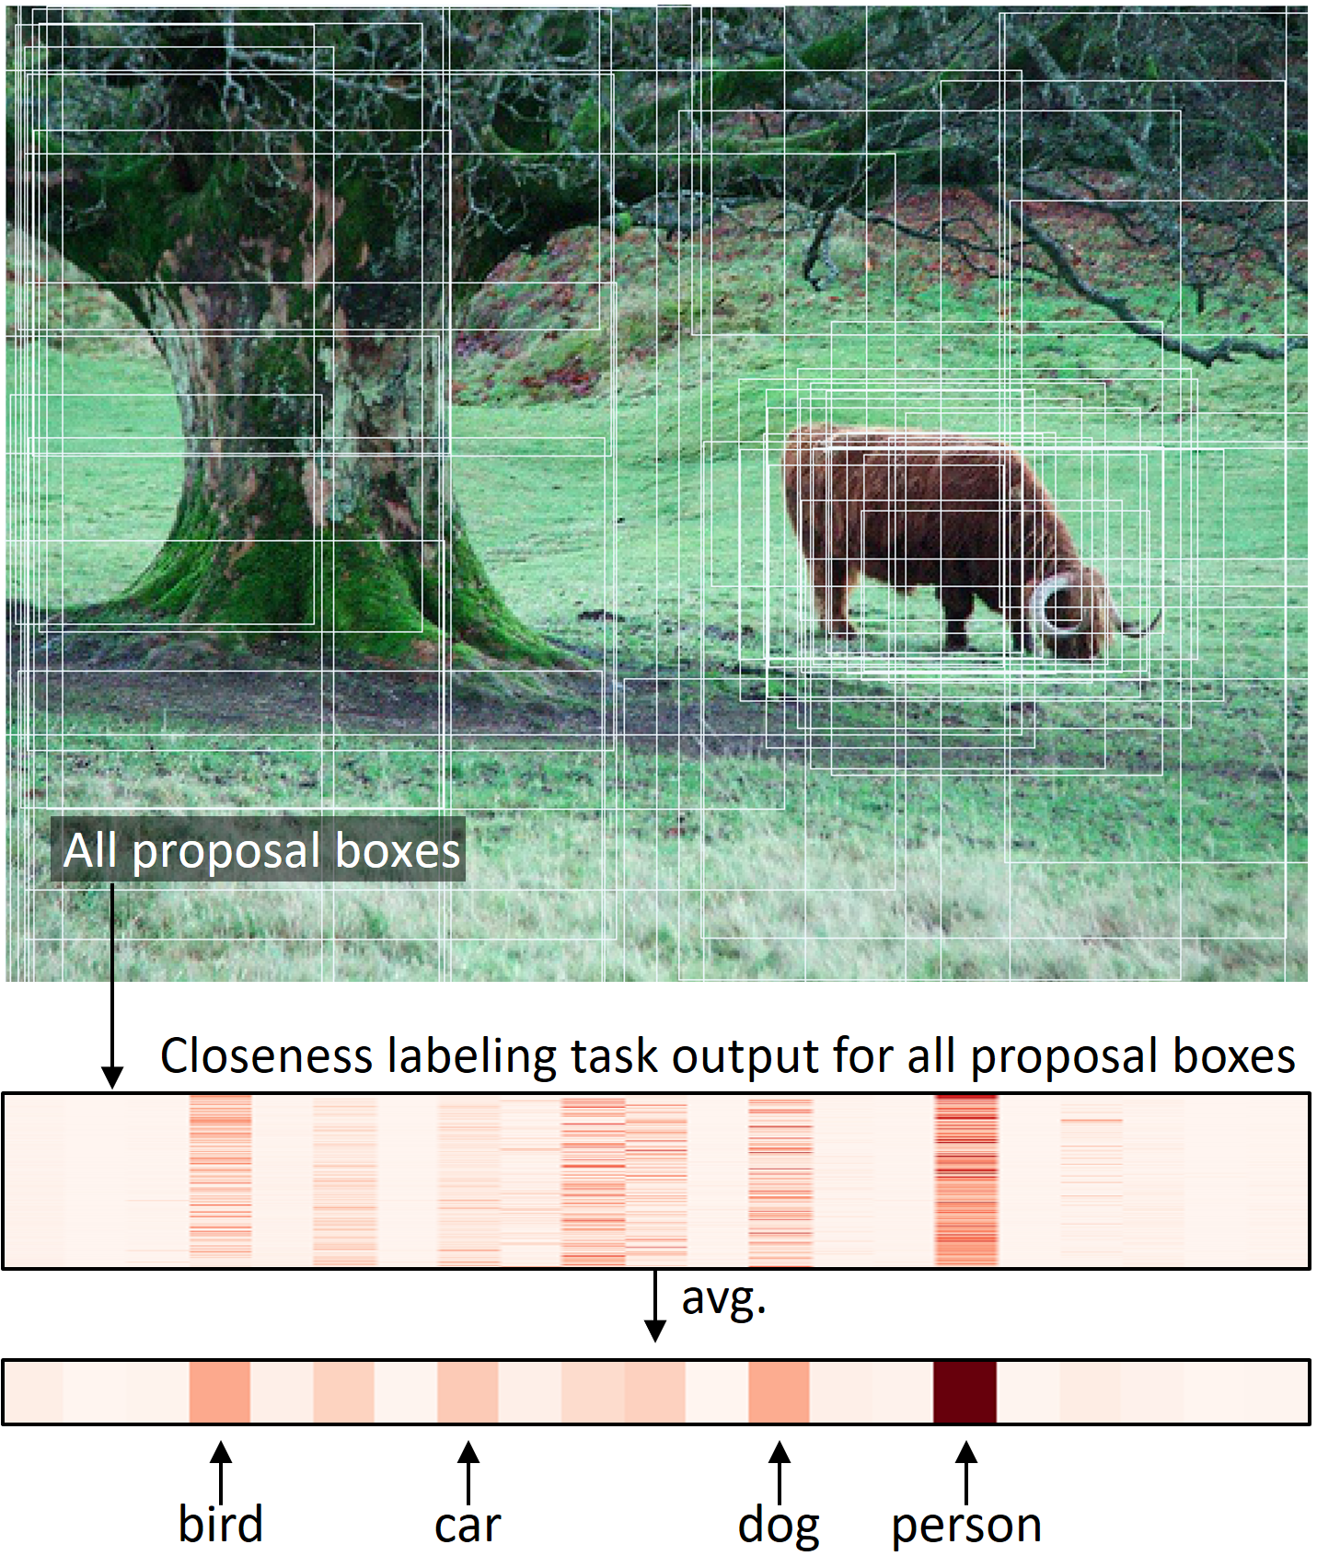
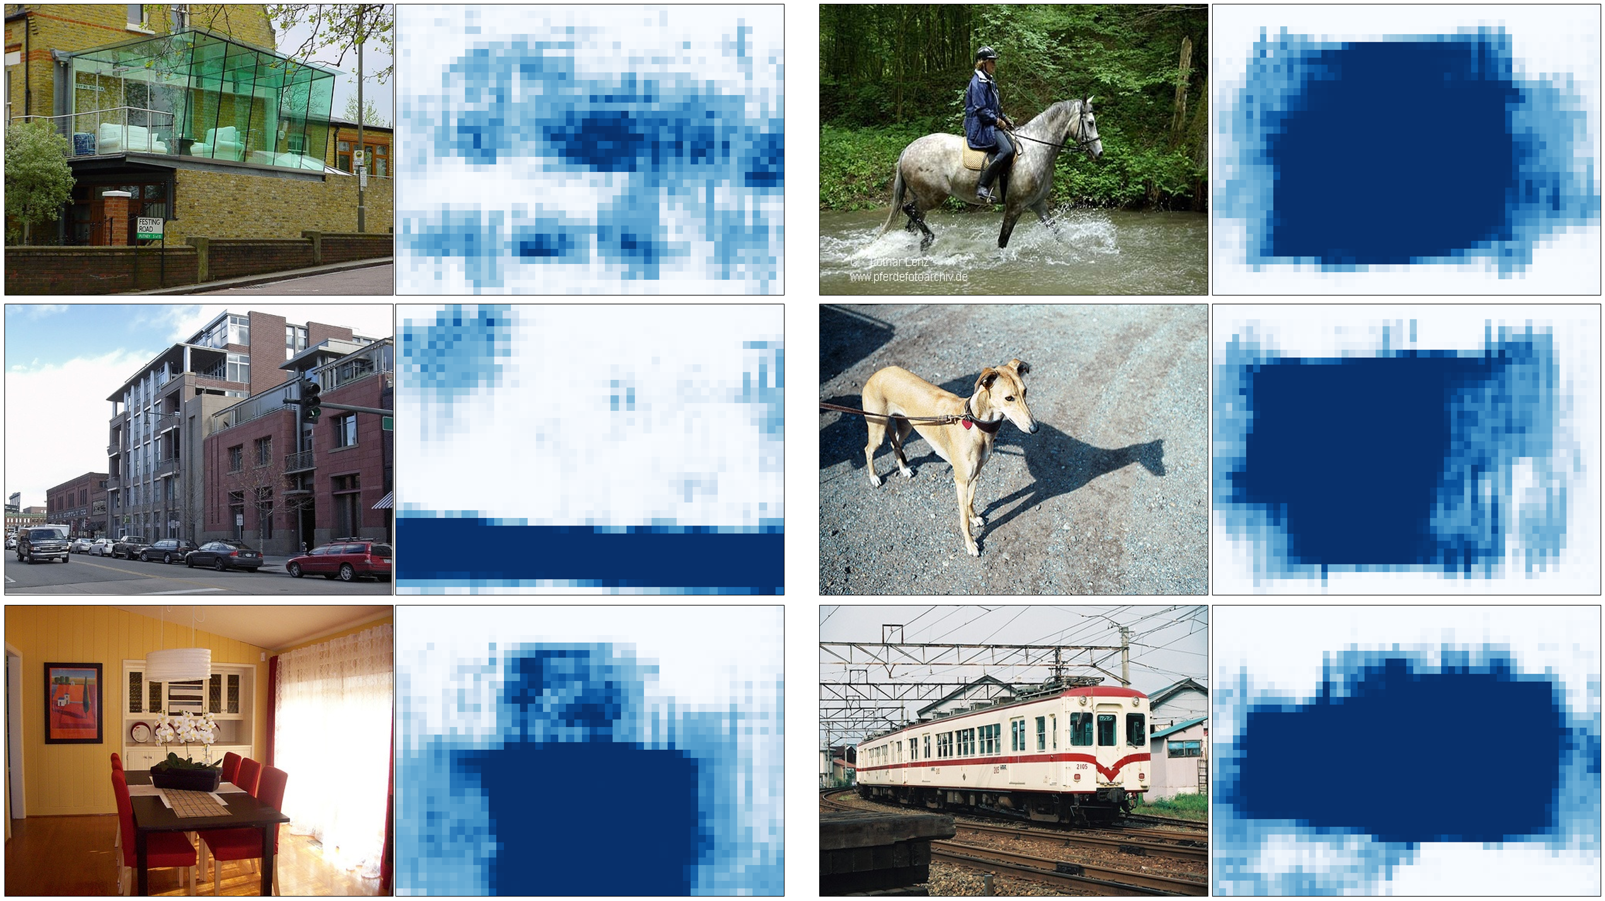
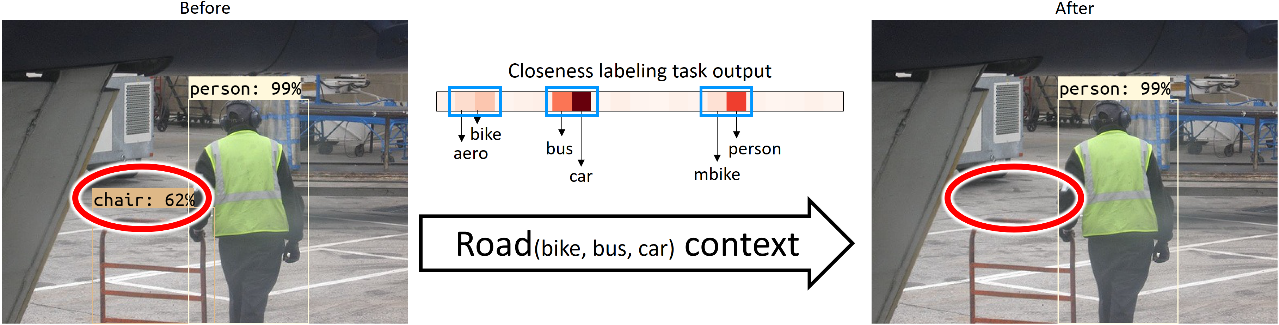
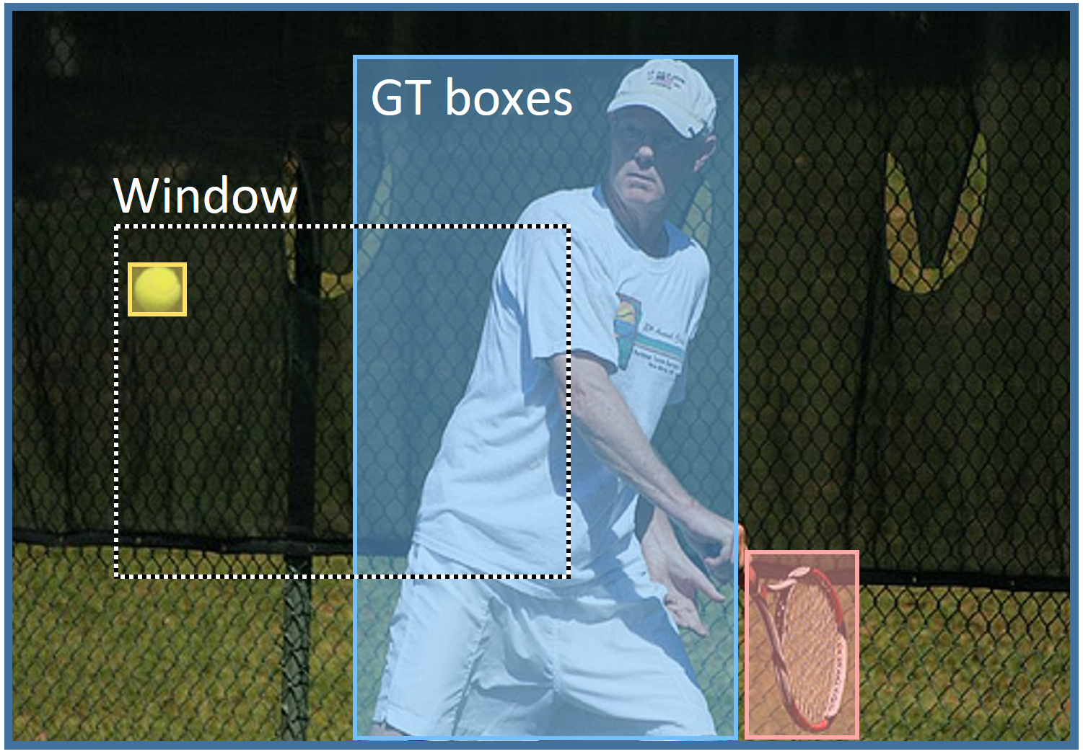
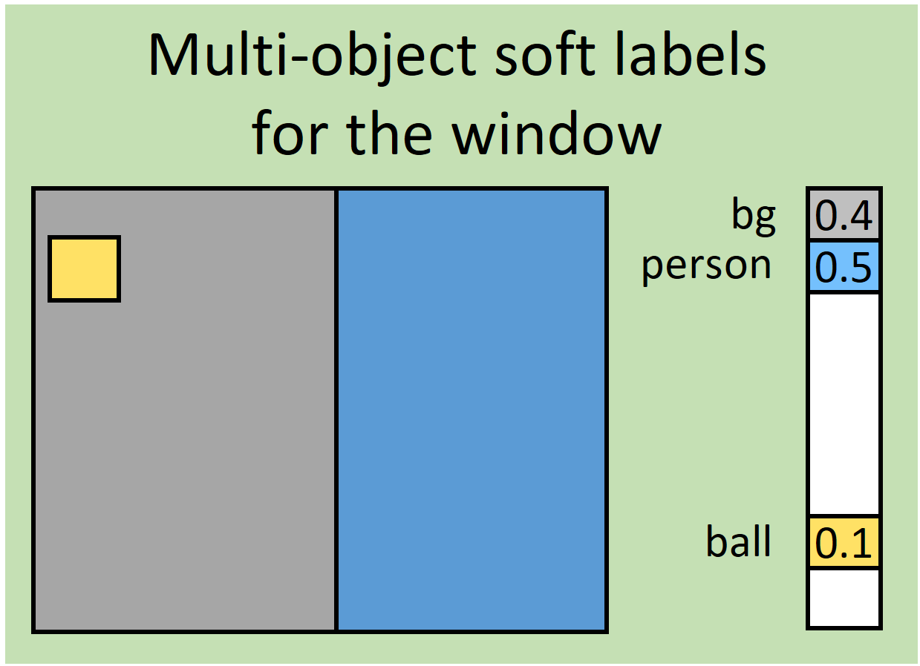
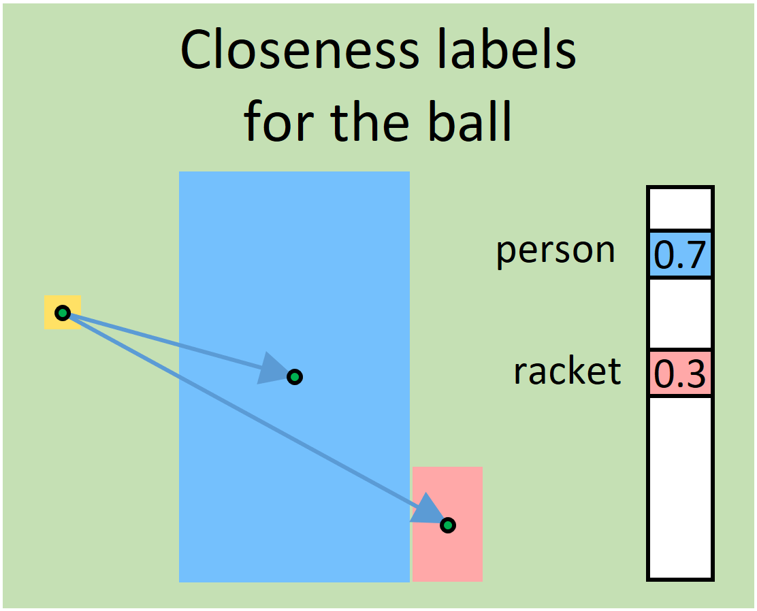
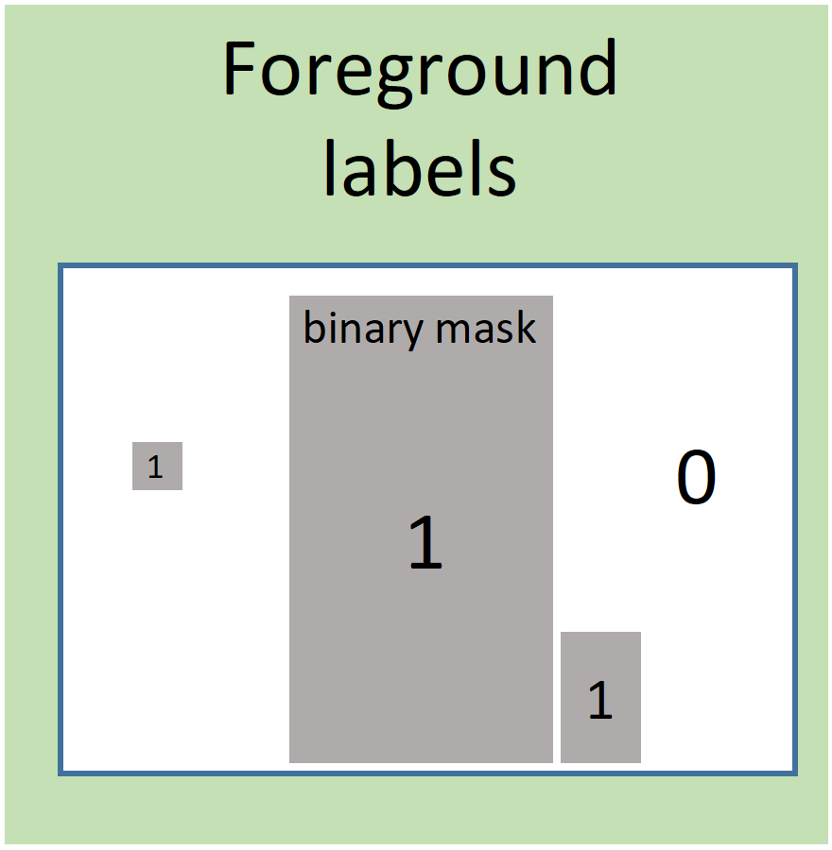
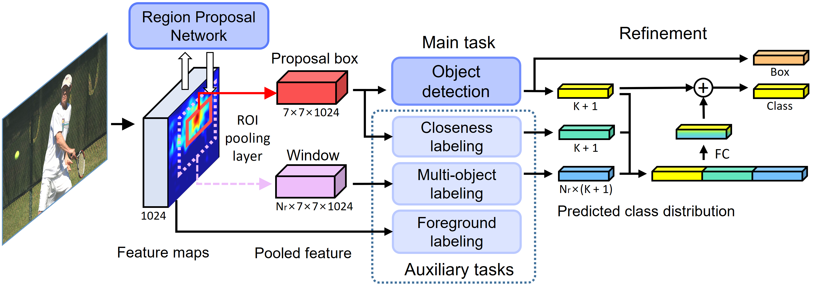
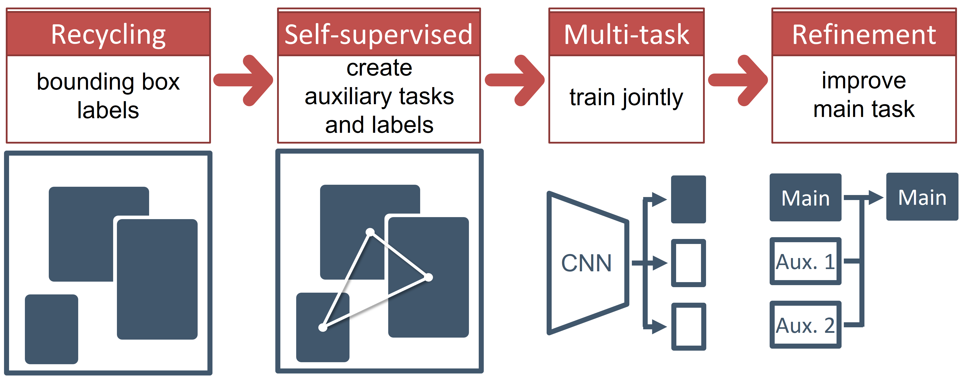
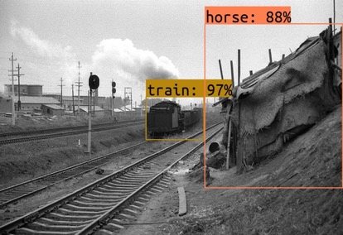
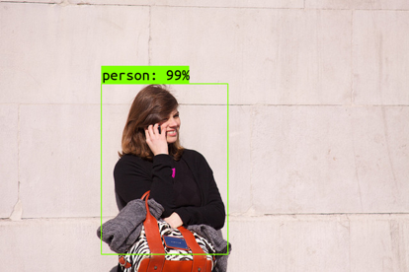
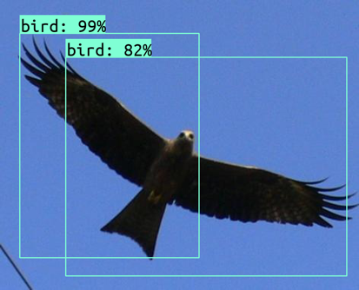
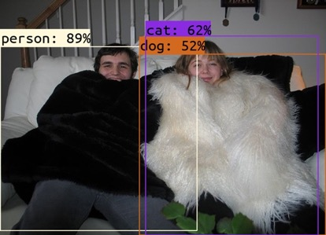
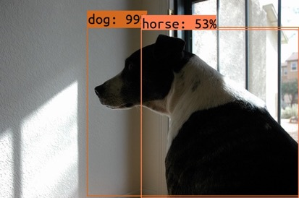
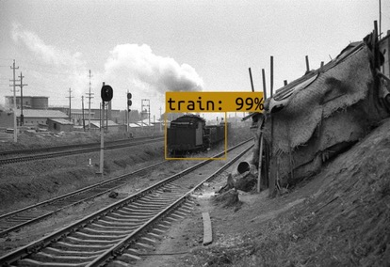
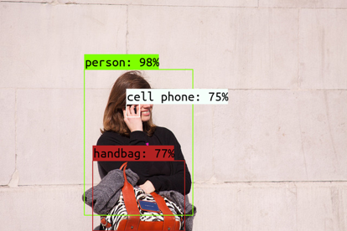
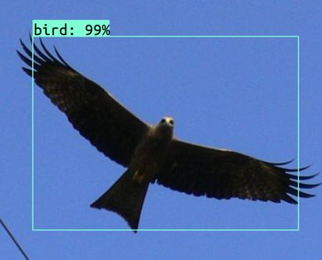
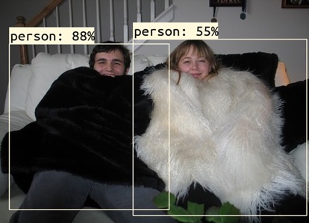
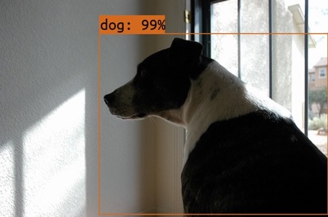
Multi-task Self-supervised Object Detection via Recycling of Bounding Box Annotations
Wonhee Lee
Seoul National University
Joonil Na
Seoul National University
Gunhee Kim
Seoul National University
Code: https://github.com/wonheeML/mtl-ssl
Objective
Three Auxiliary Tasks
Refinement via Context Information
Improve the object detection accuracy using three ideas:
Multi-object labeling
Closeness labeling
Foreground labeling
Multi-task learning: train multiple relevant tasks jointly
Self-supervised learning: train with labels generated by itself
Annotation recycling: make use of given GT BBoxes in various ways
A soft label of a random window according to the portion of area for each class within it
Benefit: consider surrounding context information together
Three self-supervised auxiliary tasks
A soft label of a GT box by the distances to other nearby GT boxes
Benefit: predict objects in the neighborhood
A binary mask for foreground and background
Benefit: localize exact object boundaries
Contributions
A first attempt to recycle BBox annotations for object detection
Orthogonal to any proposal-based detection models
Improvement (mAP 2.0↑ on avg) in multiple architectures
Results of Object Detection
Consistently enhance the performance in various combinations
Architecture
Dataset | Backbone | Detector | Baseline | Ours | ΔmAP
VOC 2012 | ResNet101 | FRCNN | 75.3 | 77.5 | 2.2↑
VOC 2012 | ResNet101 | R-FCN | 72.1 | 73.9 | 1.8↑
VOC 2012 | MobileNet | FRCNN | 62.0 | 64.4 | 2.4↑
VOC 2012 | Inception-ResNet-v2 | FRCNN | 78.2 | 80.0 | 1.8↑
COCO 2017 | ResNet101 | FRCNN | 32.8 | 34.7 | 1.9↑
Our Idea
Start from the conventional detection setting with BBox annotations
Propose three auxiliary tasks that self-train by creating their own labels
Train main and auxiliary tasks jointly for cooperative feature learning
Refine the classification result using auxiliary task outputs
Examples of improvement for various types of errors
Background
False Negative
Localization
Classification
Redundancy
How object detection improves?
Multi-task learning enhances the feature learning via feature sharing between four tasks
The refinement better predicts the class of a box by jointly using contextual information in the auxiliary task output

